Slide 1
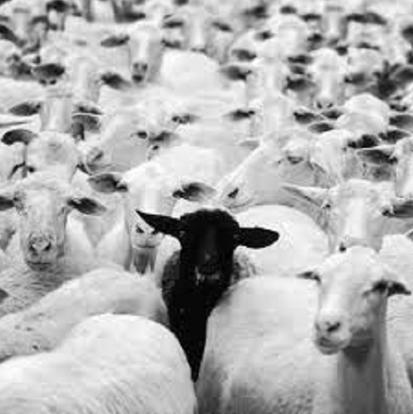
Anomalies in Science
How does a paradigm deal with its black sheep?

Slide 2
Looking back (and forward!)…
What is a paradigm?
What is a theory? Or hypothesis?
What does Kuhn mean by “Normal Science?”here is a great example
What is the relationship between normal science and novelty? What do scientists set out to discover?
What is Kuhn’s position on truth and scientific theories?

Slide 3
a·nom·a·ly
əˈnäməlē/
noun
1.
something that deviates from what is standard, normal, or expected.
"there are a number of anomalies in the present system"

Slide 4
Some Example Anomalies
The discovery of Neptune (a triumph of the paradigm)
The Michelson-Morley Experiment (an example of the “logic of justification”)
The orbital precession of Mercury (a re-interpretation of the paradigm)
The Photoelectric Effect (a failure of the paradigm)

Slide 5
Neptune
Uranus “discovered” in 1781 by Herschel
Within a few decades its orbital motion was “weird”
What was “expected”…

Slide 6
Neptune
What was observed …

Slide 7
Was the paradigm wrong?
$F=−G\frac{Mm}{r^{2}}$ might not work at the distance Uranus was from the Sun?
Maybe$=−G\frac{Mm}{r^{2.005}}$ works better…

Slide 8
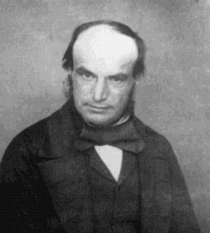
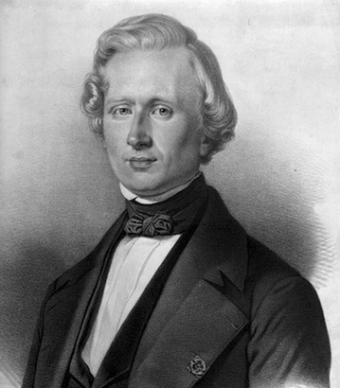
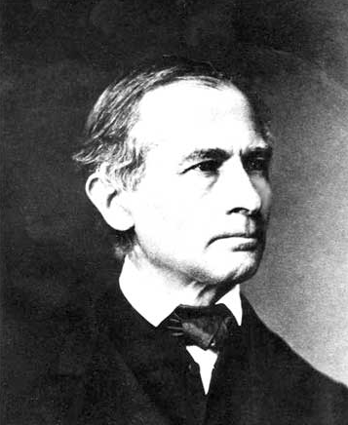
The Paradigm strikes back!
Using the Paradigm John Couch Adams and Urbain Le Verrier predict (independently in 1846) the existence of a new planet!
Johanne Galle discovers this new object close to the position supplied by Le Verrier’s calculations the same evening he received them!
John Couch Adams
Johanne Galle
Urbain Le Verrier

Slide 10
Paradigms Re-interpret themselves - Michelson-Morley Experiment
The “greatest experiment that never worked!”
Was intended to reveal Earth’s motion through the aether
Series of experiments from 1882 - 1887

Slide 11
When No means NO!
In HINDSIGHT the experiment can be understood using
Einstein’s Theory of Special Relativity – ie “Logic of Justification”
MM experiment forced a radical re-intepretation of basic understandings (paradigms) in classical physics but physics remained “classical”

Slide 12
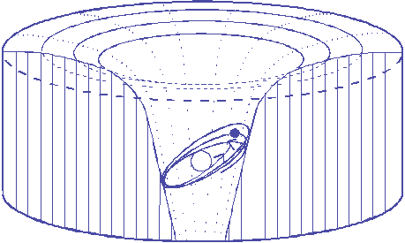
More re-interpretation: Perihelion advance of Mercury
Even after accounting for known masses in the solar system Mercury’s orbit showed a persistent extra shift of 43” per century*
* 43” is a gap of 2mm as seen from a distance of 10m!

Slide 13
You can’t get there from here: When Paradigms fail
The photoelectric effect was first noticed by Hertz in 1887
Lenard began series of critical experiments in ~1902
Einstein proposes particle model of light in 1905
Millikan conducts “definitive” experiment in 1915
Classical physics had no way of incorporating Einstein’s explanation into existing paradigms

Slide 15
To sum up…
Anomalies arise naturally in mature science but are not an intended or predictable part of normal science
Persistent inability to resolve/re-interpret anomaly leads to revolution

